Slide 1

NOVEL: ‘Matilda’
By Roald Dahl
PREPARED BY MISS ALISHA ILYAS

Slide 2
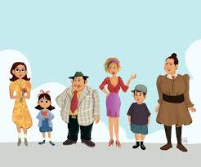
INTRODUCTION OF ALL THE CHARACTERS

Slide 3
NOVEL DESCRIPTION
Matilda" by Roald Dahl is about a smart little girl named Matilda who loves to read. Her parents are mean to her and don't understand her. At school, the headmistress, Miss Trunchbull, is very cruel. Matilda discovers she has special powers that let her move things with her mind. With the help of her kind teacher, Miss Honey, Matilda uses her powers to stand up to Miss Trunchbull. In the end, Matilda finds happiness and a loving home. This story shows that being clever and kind can help overcome any problem.

Slide 4
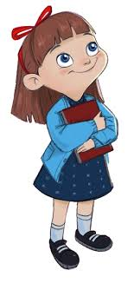
MATILDA
Intelligent and Precocious: Matilda is exceptionally intelligent for her age, showing a love for reading and learning.
Independent: She often takes care of herself, as her parents neglect her.
Resourceful and Clever: Matilda uses her cleverness to play pranks on her family and later uses her telekinetic powers to help Miss Honey.
Kind-Hearted: Despite her mistreatment, Matilda remains kind and seeks justice for those who are wronged.

Slide 5
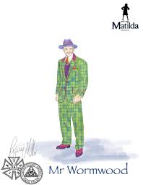
Mr. Wormwood
Dishonest Car Salesman: Mr. Wormwood is Matilda's father, a dishonest car salesman who frequently cheats his customers.
Ignorant and Dismissive. He is greedy, arrogant, and dismissive of Matilda's intelligence, preferring instead to belittle and insult her.
Mean-Spirited: Mr. Wormwood shows more interested in making quick money than in ethical behavior or nurturing his children.

Slide 6
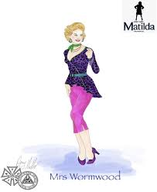
Mrs. Wormwood
Self-Centered: Obsessed with her appearance and watching television.
Neglectful Mother: Pays little attention to Matilda's needs and is more interested in bingo.
Uninterested in Education: Does not value academic achievement and dismisses Matilda’s intelligence.

Slide 7
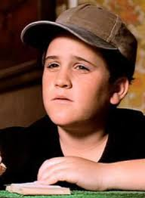
MICHAEL WORMWOOD
Matilda's Older Brother: Often favored by their parents despite being less intelligent than Matilda.
Average and Unremarkable: Lacks Matilda’s exceptional abilities and interests.

Slide 8
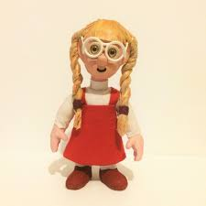
AMANDA THRIPP
Victim of Miss Trunchbull: A student at Crunchem Hall who is picked on by Miss Trunchbull for her pigtails.
Innocent and Playful: Represents the typical child at the school who suffers under Trunchbull’s tyranny.

Slide 9
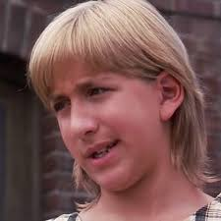
HORTENSIA
Rebellious Student: An older girl at Crunchem Hall who has a reputation for standing up to Miss Trunchbull.
Courageous and Bold: Shares stories of her defiance with Matilda and Lavender, inspiring them.
Victimized: Despite her bravery, she often faces harsh punishments from Miss Trunchbull.

Slide 10
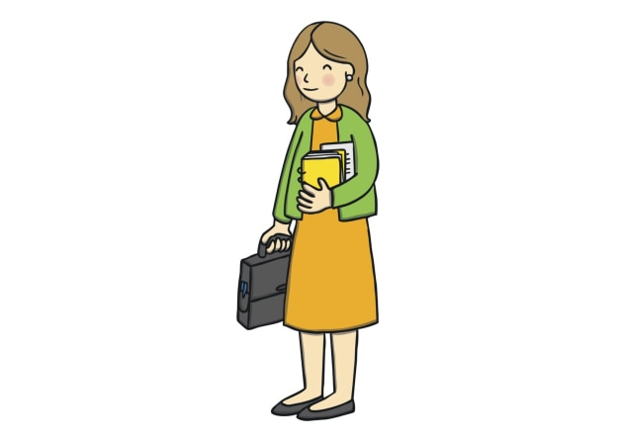
Miss Honey
Kind and Supportive Teacher: Matilda’s class teacher who recognizes and nurtures her intelligence.
Timid and Gentle: Has a gentle demeanor but is initially afraid to stand up to Miss Trunchbull.
Tragic Backstory: Orphaned and mistreated by her aunt, Miss Trunchbull, who took her inheritance.

Slide 11
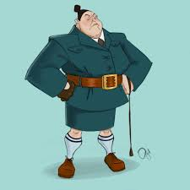
Miss Trunchbull
Tyrannical Headmistress: The cruel and abusive headmistress of Crunchem Hall Primary School.
Formidable and Intimidating: Known for her physical strength and terrifying presence.
Bullying and Punitive: Enjoys punishing children in extreme ways, such as using the "Chokey."

Slide 12
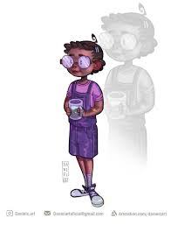
Lavender
Matilda’s Best Friend: A brave and adventurous girl who befriends Matilda.
Prankster: Shares Matilda’s sense of mischief, like putting a newt in Miss Trunchbull’s water jug.
Loyal and Supportive: Stands by Matilda and supports her against Miss Trunchbull.

Slide 13
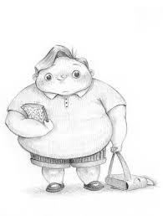
Bruce Bogtrotter
Victim Turned Hero: A boy at Crunchem Hall who is forced to eat an enormous cake by Miss Trunchbull as punishment.
Resilient and Determined: Successfully finishes the cake, becoming a hero among the students.
Symbol of Defiance: Represents the students’ resistance to Miss Trunchbull’s cruelty.

Slide 14
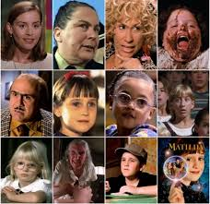
ACTIVITY : STUDENTS WILL DISCUSS FEW LINES ABOUT THEIR FAVOURITE CHARACTER WITH THEIR CLASS MATES

Slide 15
THANK YOU

